Slide 1
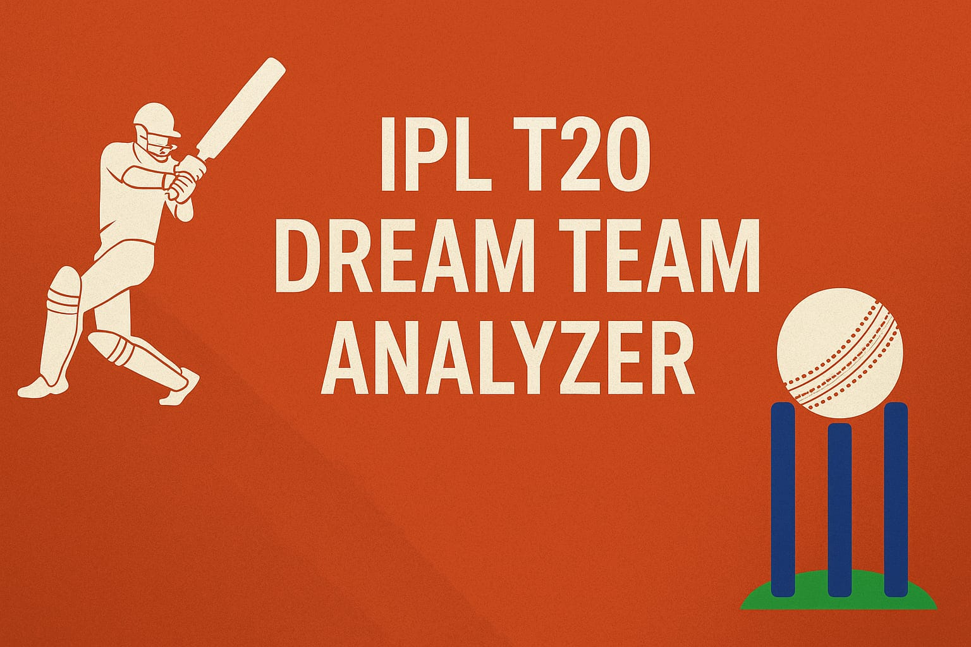

Slide 2

Problem Statement
Selecting the best 11 players manually is difficult. There are multiple factors like recent form, past performance, team balance, and match conditions that influence selection.
Requires detailed performance analysis. A fantasy team should be based on an in-depth analysis of batting, bowling.
Our project automates team selection using Power BI and. DAX This project uses Power BI dashboards and DAX formulas to filter and rank players automatically.

Slide 3
Objectives
Analyze historical IPL data to find top performers.
Visualize performance trends for players and teams.
Suggest an optimized "dream team" based on consistency and contribution.

Slide 4
Data Collection Process

Slide 5
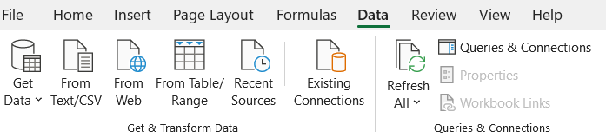
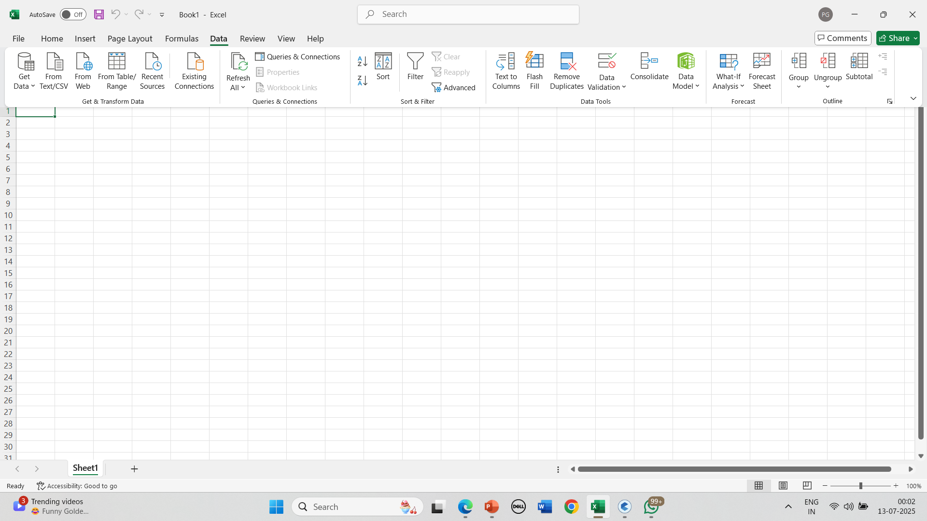
Collection of data
Data collected using Excel from ESPNcricinfo.
Step of collection Open Excel new sheet, there we had Ribbon tabs where we have Data tab.
Here in data tab we have tab as ‘From Web’, so from there we had got the data.

Slide 6
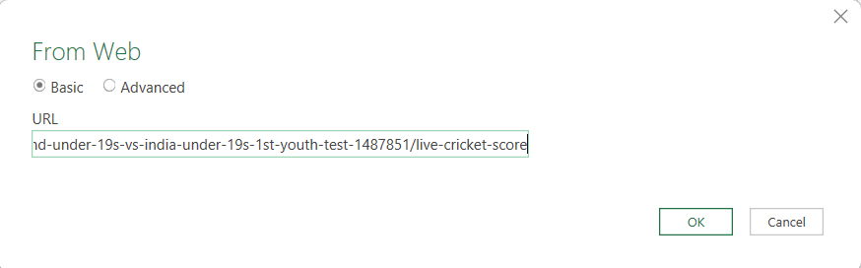
After clicking on from web we get open a tab like this,
So now here we need to paste the URL from the website we getting data from. Like I had used website ESPNcricinfo.

Slide 7
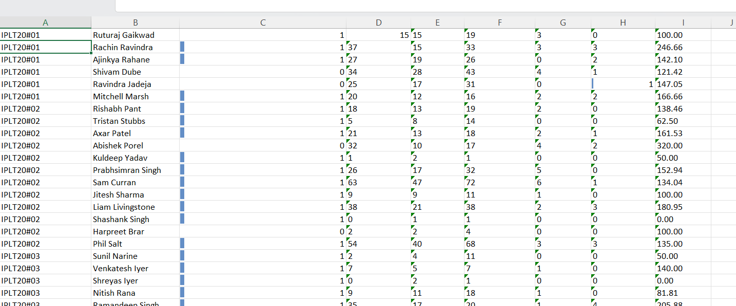
Here I got this type of data in excel.

Slide 8
Data cleaning and Preprocessing
Remove duplicate or irrelevant data.
Handle missing or incorrect values.
Convert data types (e.g., text to numbers).
Normalize or standardize fields if needed
Notes:
Remove duplicate or irrelevant data.
Handle missing or incorrect values.
Convert data types (e.g., text to numbers).
Normalize or standardize fields if needed.

Slide 9
Work Moves Towards Power BI

Slide 10
Import data in power bi and do transformation is done through ‘power query’.
Made some calculate measures like, batting strike rate, bowling strike rate, and many more.
This measure used for making visuals.
E-R model in this making relationships between the tables.

Slide 11
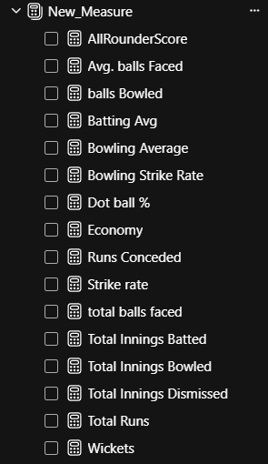
Measures Created Using DAX

Slide 12
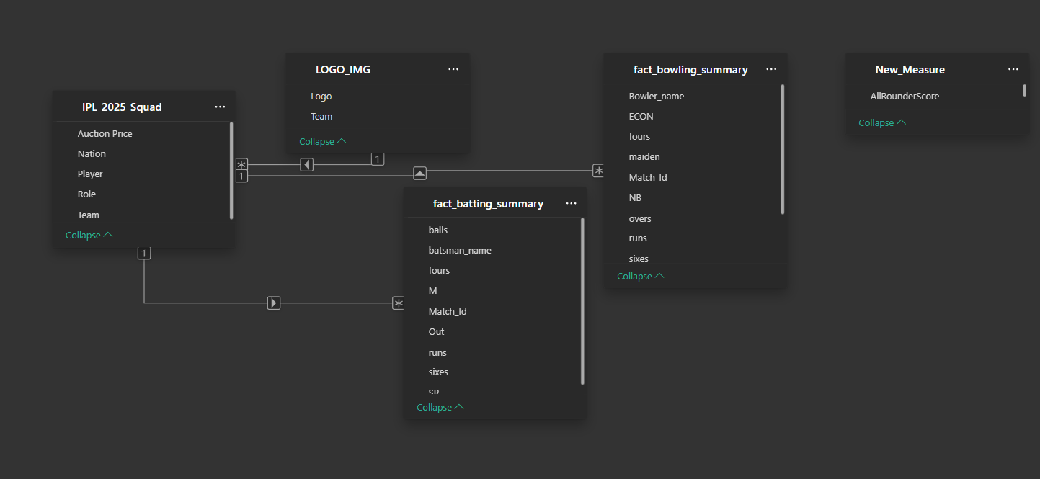
E-R Model

Slide 13
Let’s move towards the reports made.

Slide 14
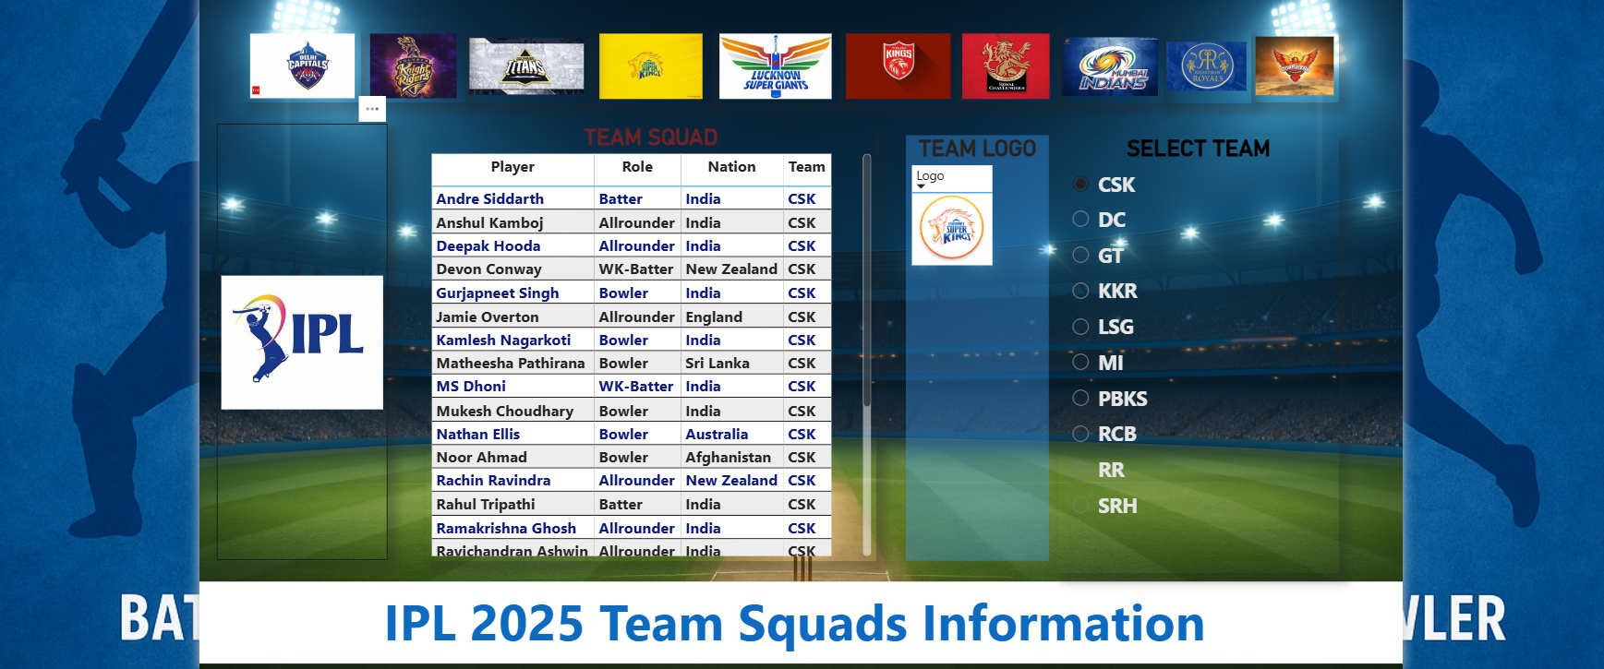
First report created

Slide 15
Now moves towards the prediction reports.

Slide 16
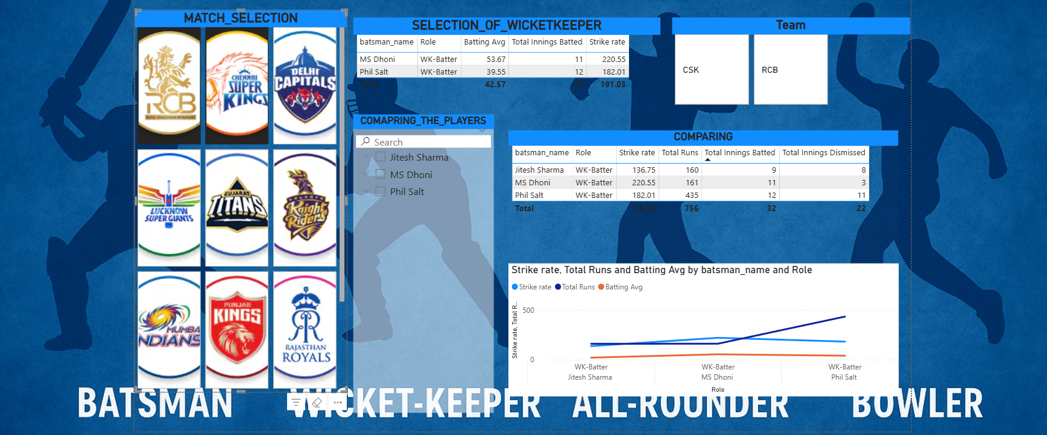
Wicket-keeper selection

Slide 17
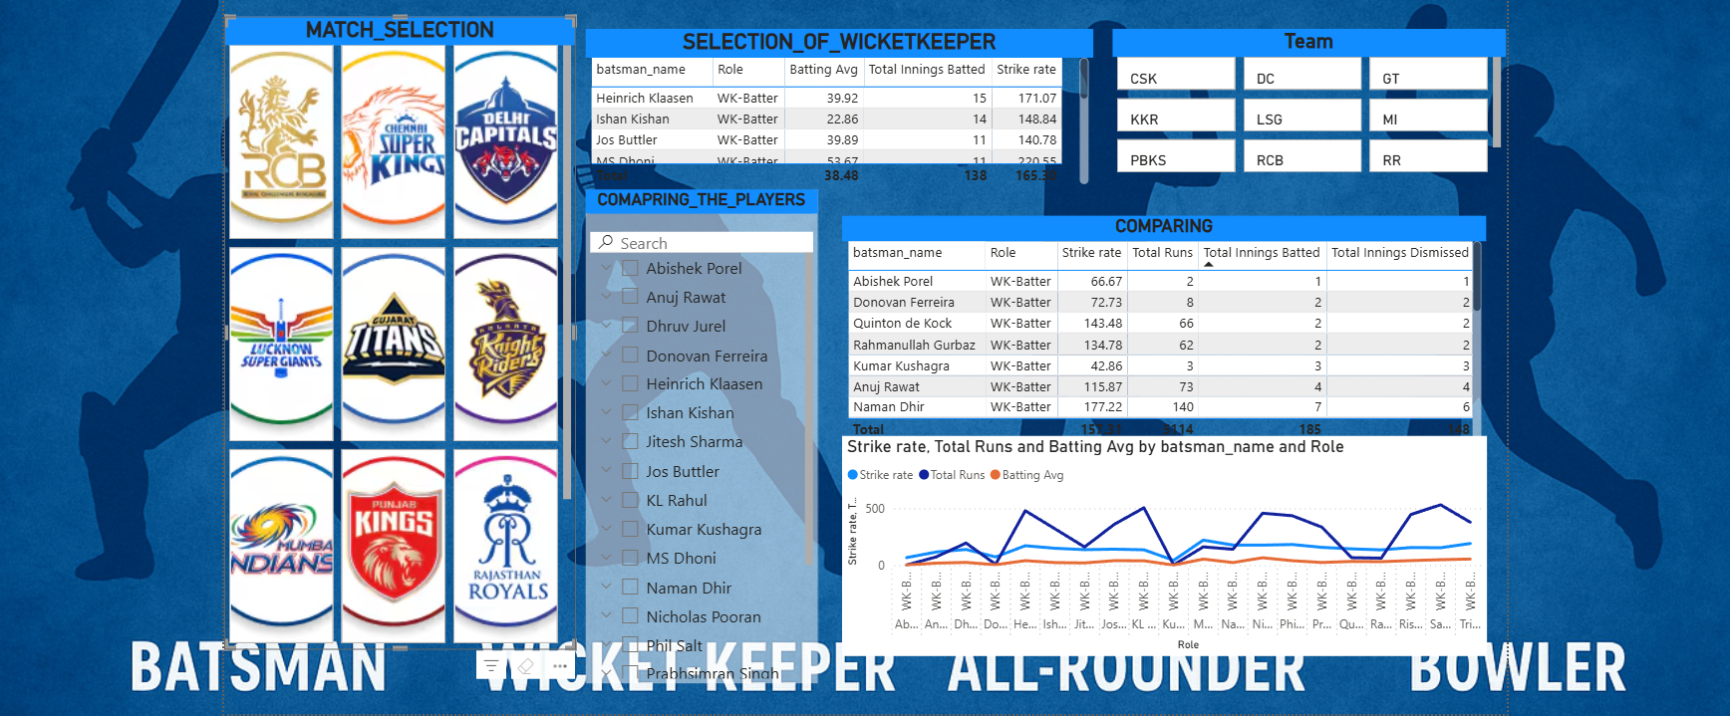

Slide 18
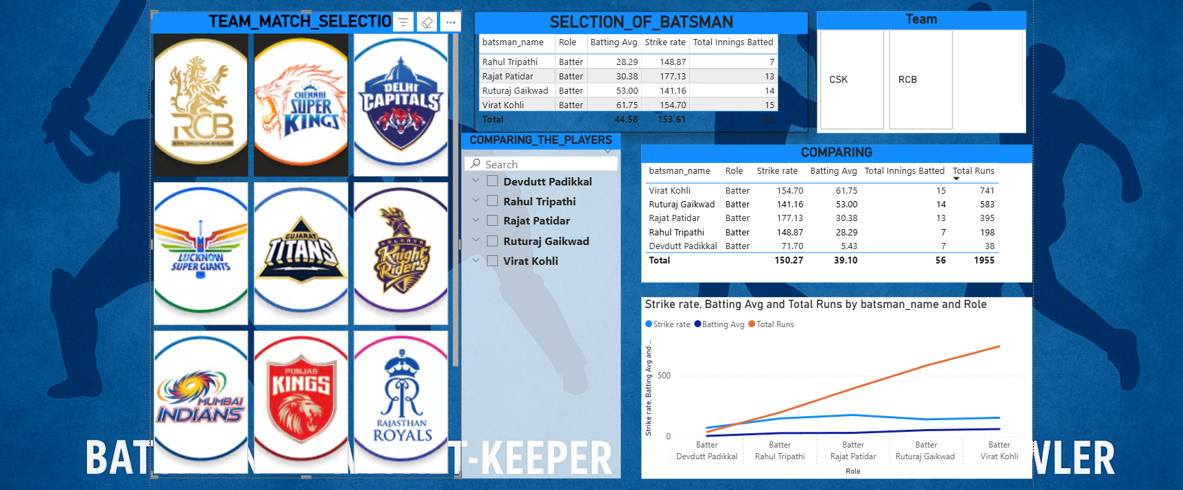
Batsman selection

Slide 19
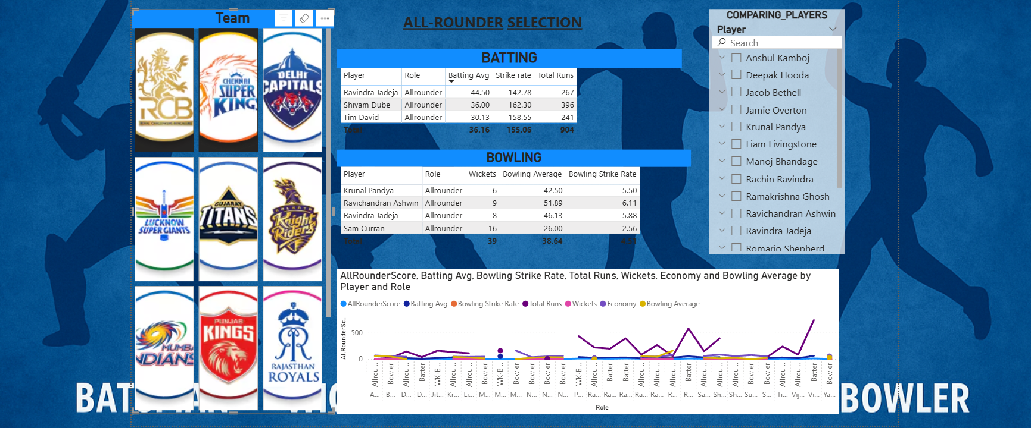
All-rounder selection

Slide 20
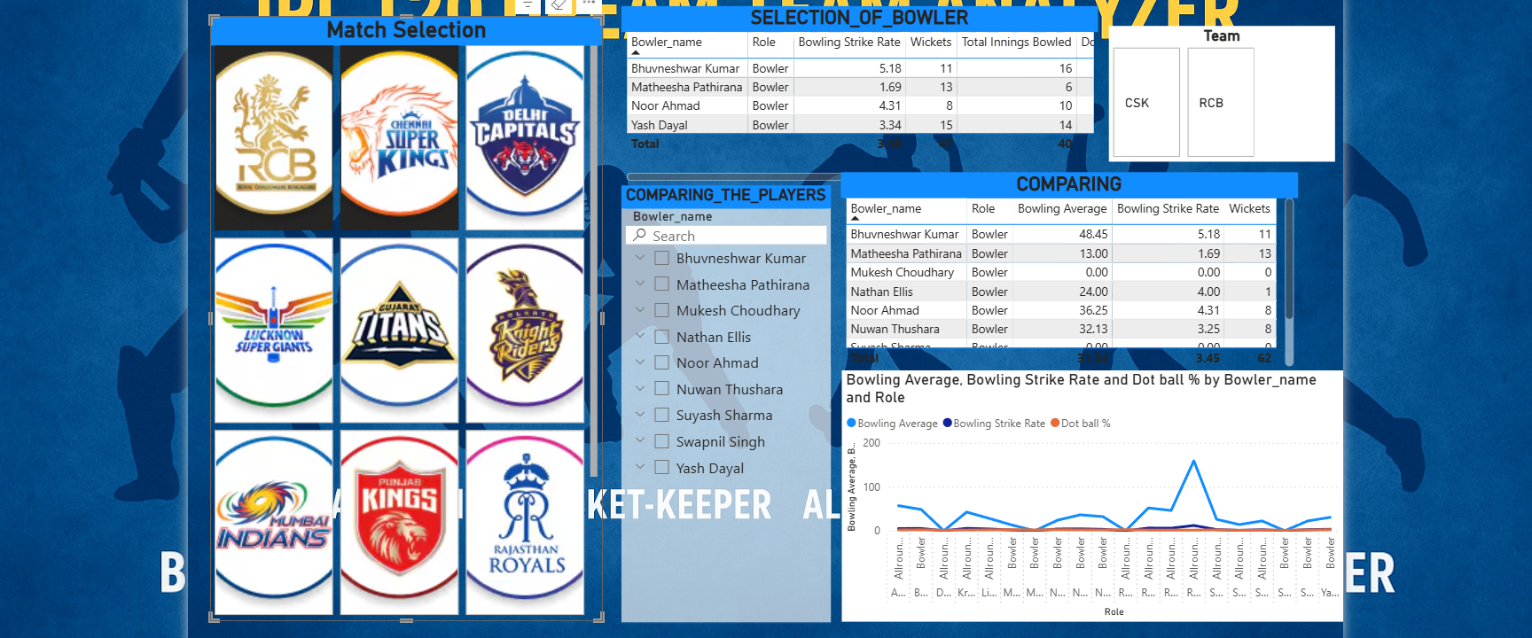
Bowlers selection

Slide 21
Thankyou

